Slide 1
CIS Workshop Scenario
Hyun

Slide 2
Workshop Scenario Overview
AdventureWorks Travel provides concierge services for business travelers.
In an increasingly crowded market, they are always looking for ways to differentiate themselves and provide added value to their corporate customers.
They are looking to pilot a web-app that their internal customer service agents can use to provide additional information useful to the traveler during the flight booking process.
They want to enable their agents to enter in the flight information and produce a prediction as to if the departing flight will encounter a 15 minute or longer delay, taking into account the weather forecasted for the departure hour.
In this workshop, attendees will build an end-to-end solution to predict flight delays taking into account the weather forecast.

Slide 3
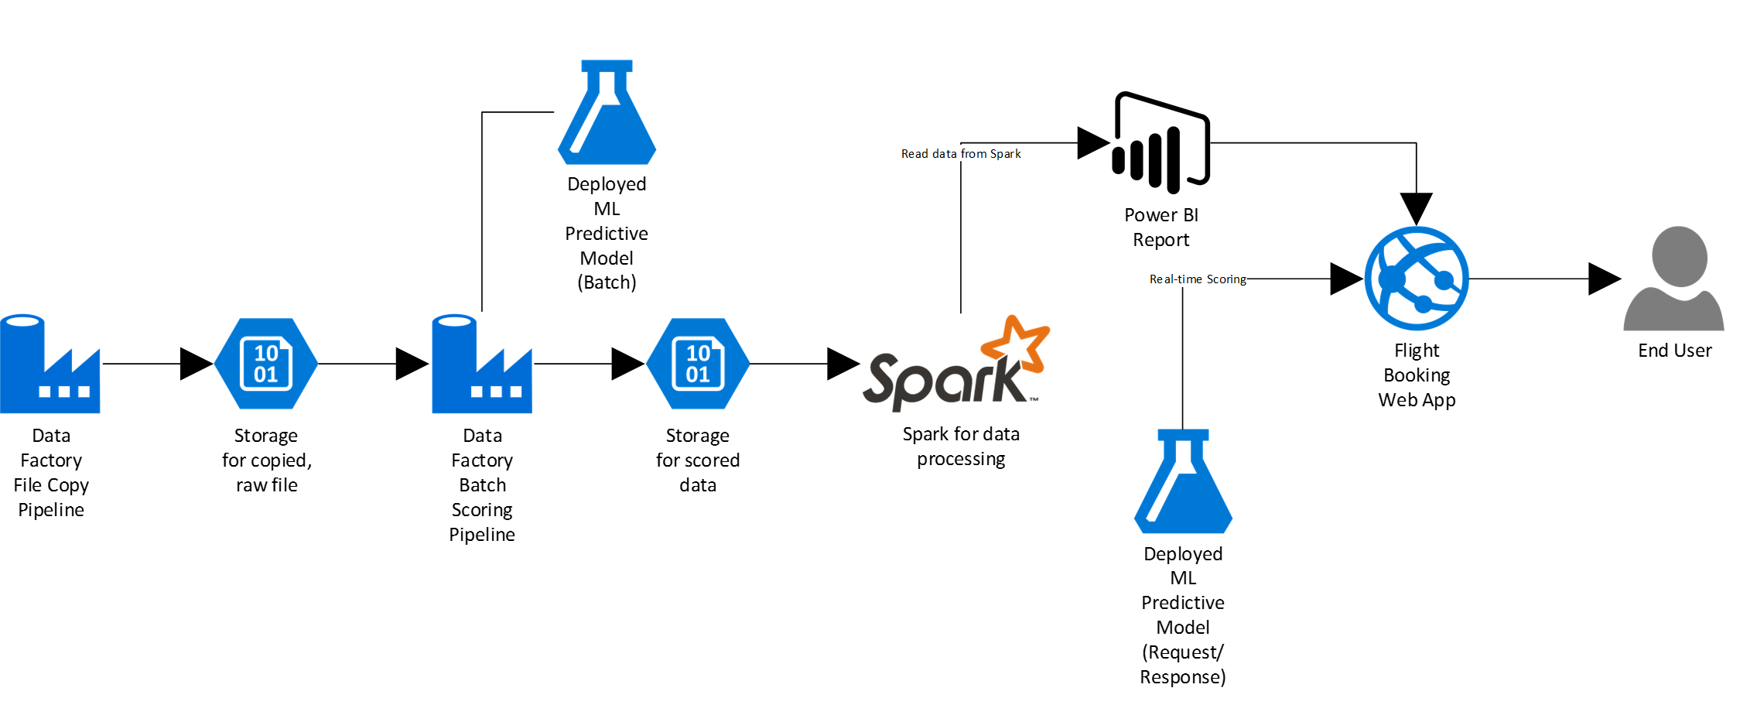
Workshop Architecture
Cortana Intelligence Suite
Azure ML
Azure Data Factory
Azure Storage
HDInsight Spark
Power BI
Azure App Service

Slide 4



Transform data into intelligent action
Information Management
Big Data Stores
Machine Learning and Analytics
Intelligence
People
Data Sources
Data Factory
Data Lake Store
Machine Learning
Cognitive Services
Data Catalog
SQL Data
Warehouse
Data Lake Analytics
Bot Framework
Web
Apps
HDInsight
(Hadoop and Spark)
Mobile
Event Hubs
Cortana
Apps
Bots
Sensors and devices
Stream Analytics
Dashboards & Visualizations
Automated Systems
Power BI
Data
Data
Intelligence
Action
Notes:
T: Cortana Intelligence provides everything you need to transform your organization’s data into intelligent action. Next, let’s take a look at another demo.

Slide 5
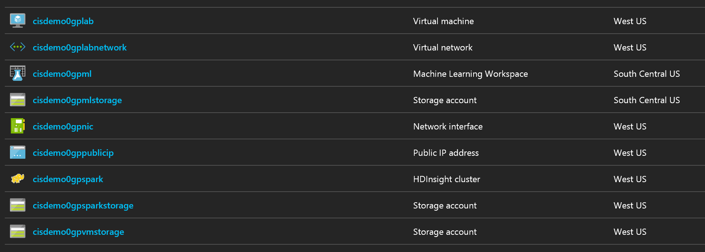
Before you start the workshop
Deploy Workshop Environment to Azure
Visit following link and deploy test/dev environment
Documents and slides are available at github
Provisioning takes 15 minutes BUT you can connect to Virtual Machine during the resource group creating status.
Find a virtual machine and connect to it using following credential
http://bit.ly/2pAsC4n
ID | Password
cortana | Password.1!!

Slide 6
Before you start the workshop
What is happening?

Slide 7
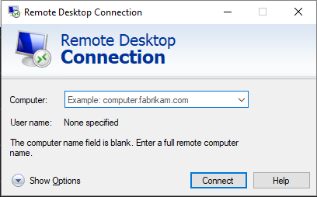
Before you start the workshop
Make sure you are working in the VM you created

Slide 8
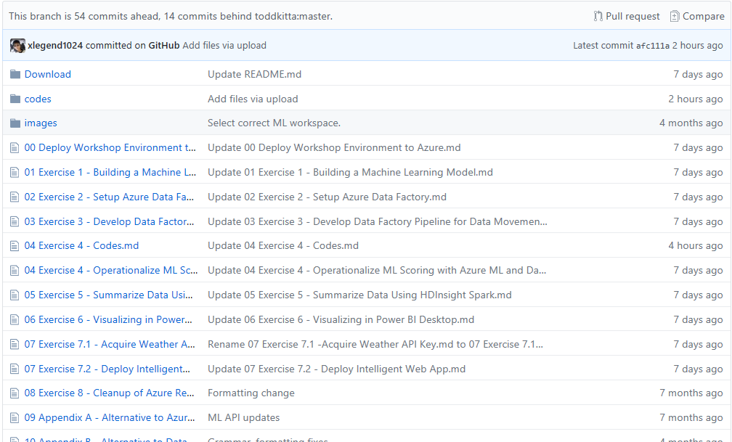
Download Workshop Manual
Make your workshop easy
http://bit.ly/2qtrDHx
User name: cortana
Password: Password.1!!

Slide 9
Cortana Intelligence Lab Exercises
Building a Machine Learning Model
Setup Azure Data Factory
Develop Data Factory Pipeline for Data Movement
Operationalize ML Scoring with Azure ML and Data Factory
Summarize Data Using HDInsight Spark
Visualizing in Power BI Desktop
Acquire Weather API Key
Deploy Intelligent Web App
Cleanup of Azure Resources

Slide 10
Ex 1: Building a Machine Learning Model
What you will see next.

Slide 11
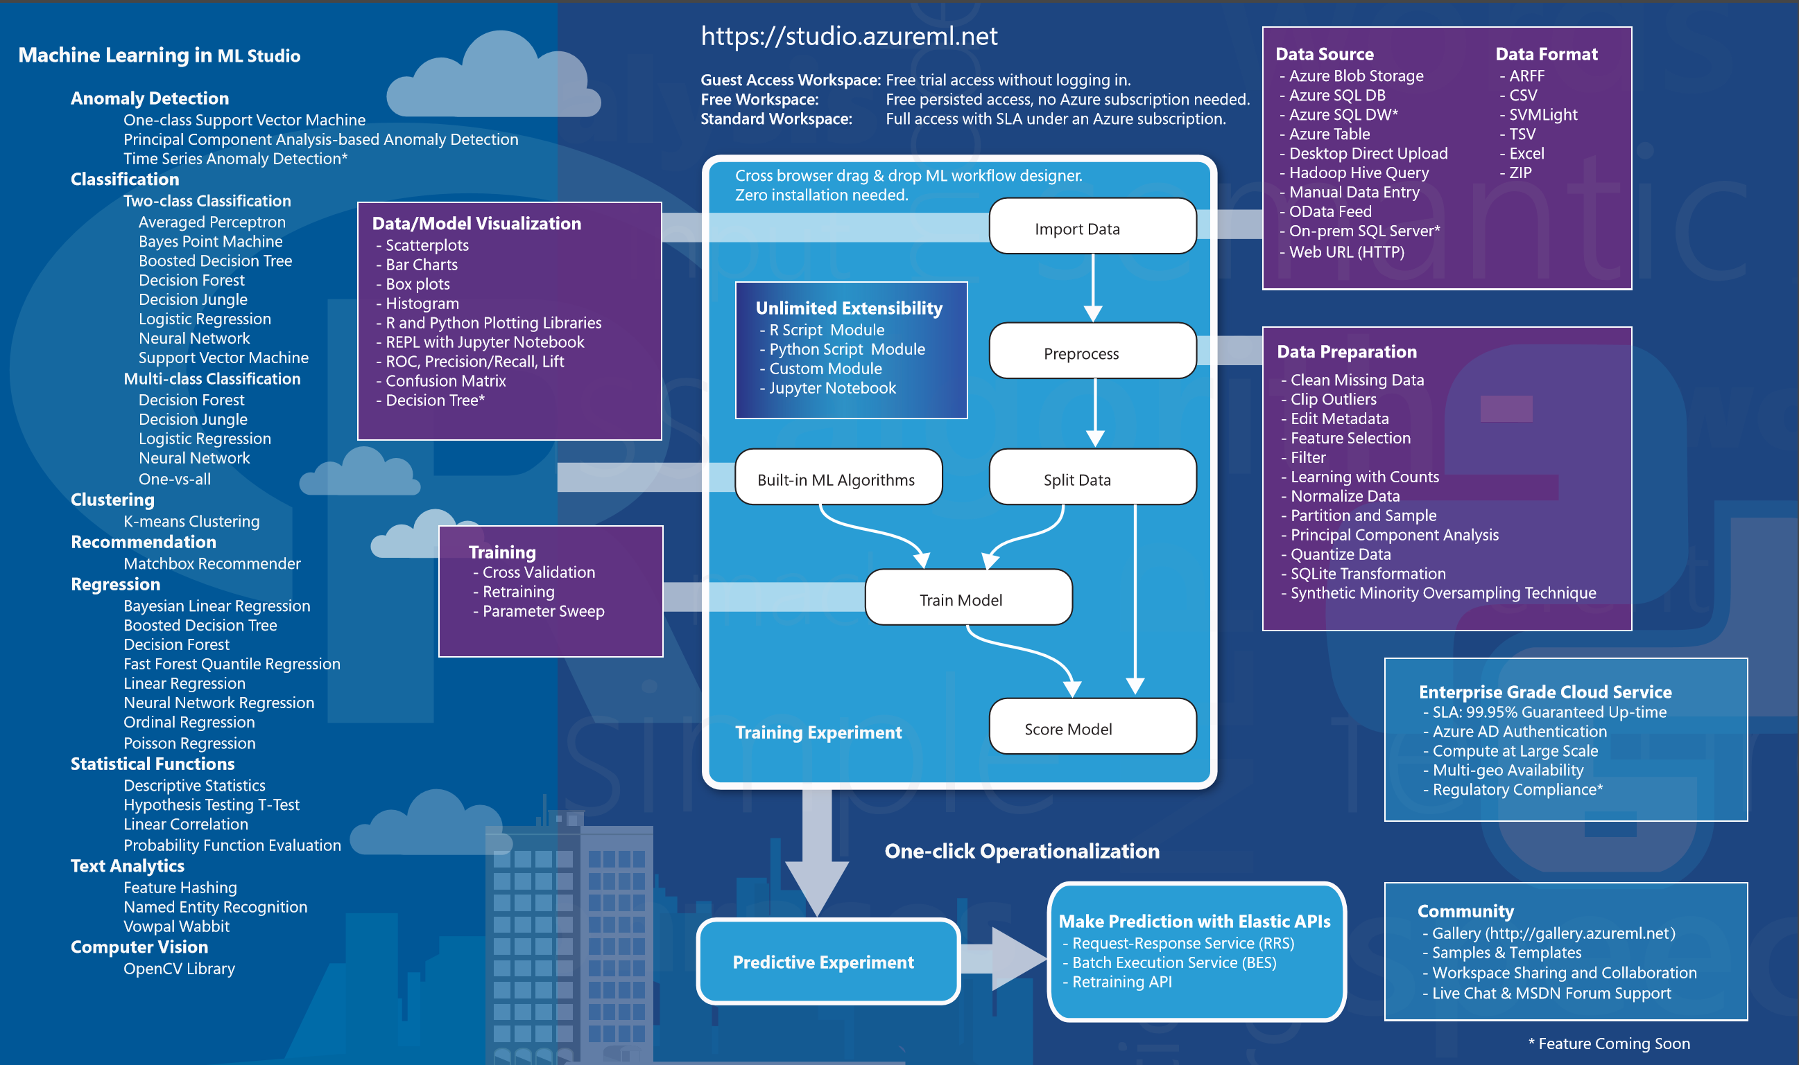
Azure Machine Learning Studio

Slide 12
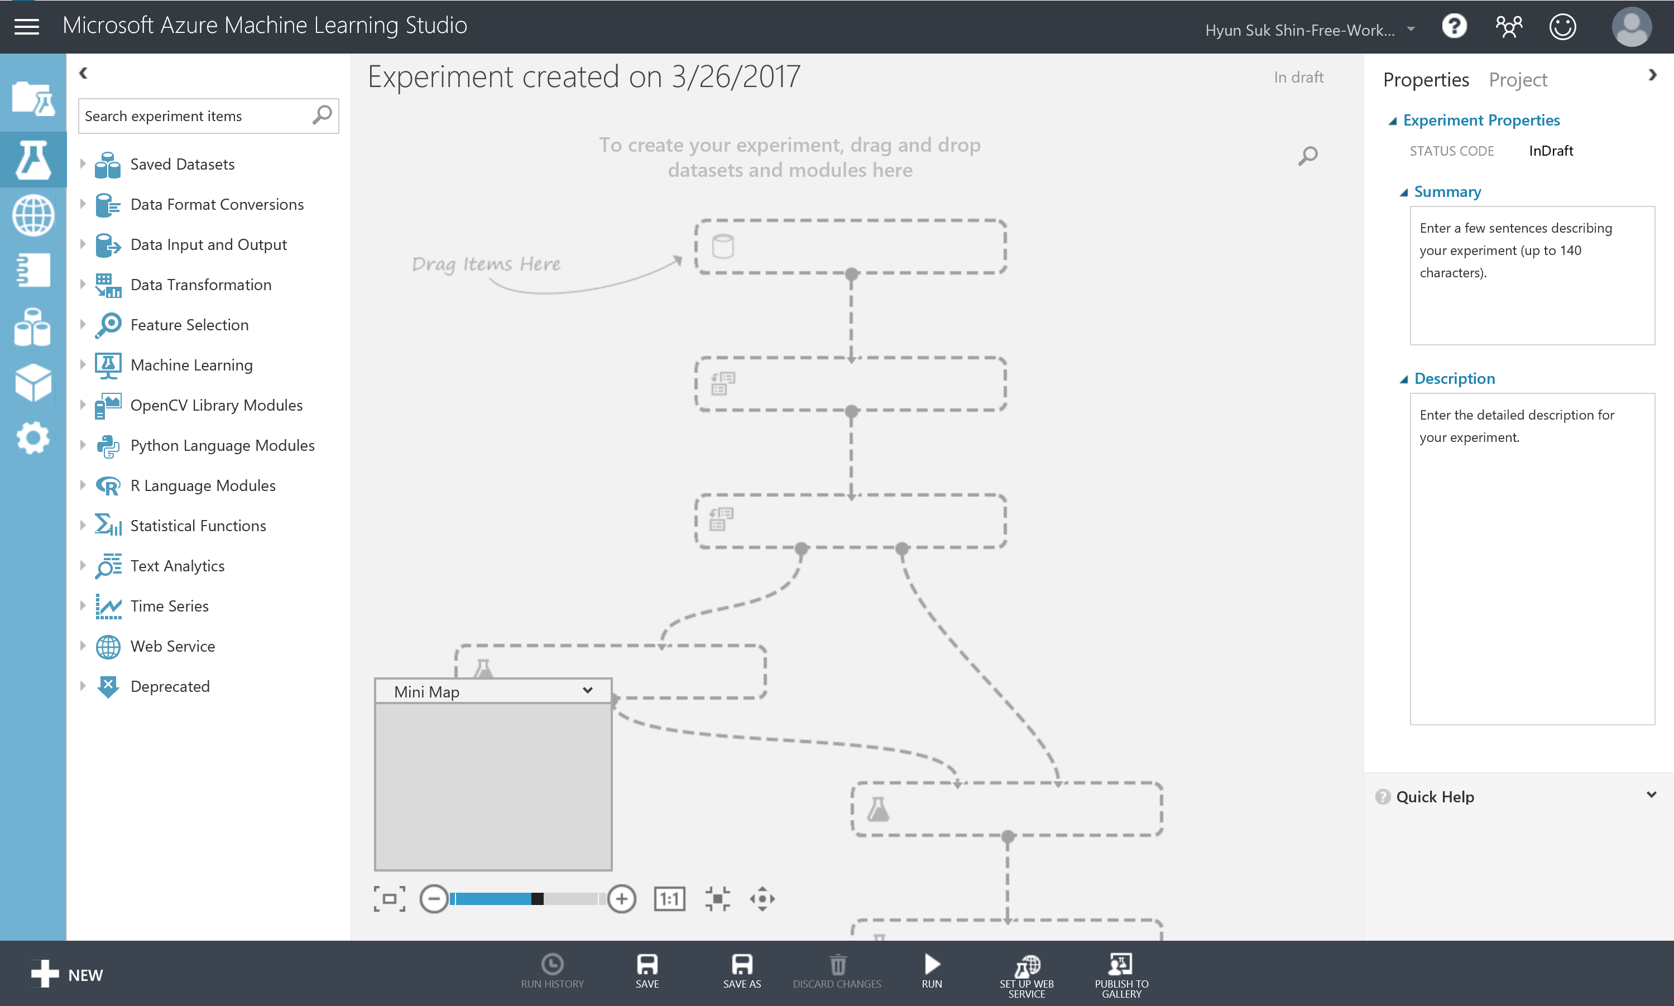
Azure Machine Learning Studio

Slide 13
Exercise 1: Building a Machine Learning Model
Tasks
1. Connect to the Lab VM
2. Navigate to Machine Learning Studio
3. Upload the Sample Datasets
4. Start a New Experiment
5. Prepare the Weather Data
6. Join the Flight and Weather Datasets
7. Train the Model
8. Operationalize the Experiment
9. Deploy Web Service and Note API Information

Slide 14
Exercise 1: Building a Machine Learning Model
Understanding Flight Delays Data Set
A flight is counted as on time if it operated less than 15 minutes later the scheduled time shown in the carriers' Computerized Reservations Systems (CRS). Source: Bureau of Transportation Statistics.
Before start implementing this experiment
Departure or Arrival Date is in HHMM format. So to round any the closest hour, we will divide it by 100 and then round the result (using floor() math operation) to get the integer number of a given number. For example: 1135. We will apply divide op.: (1135/100) = 11.35, then round op. using Floor(11.35) = 11.
Categorical Variables are those that represent a fixed number of possible values, rather than a continuous number. In this experiment, the columns Carrier, OriginAirportID, and DestAirportID represent categorical attributes.
Binning or grouping data (some time called quantization) is an important tool in preparing numeric data for machine learning. In this experiment, we are using group data into bins using Quantiles binning mode. Quantiles is also known as equal Hight binning. This applies to all numeric values in selected flight delays dataset.
In this experiment, we used sweep parameters (Tune Model Hyperparameter): Performs a parameter sweep on a model to determine the optimum parameter settings.

Slide 15
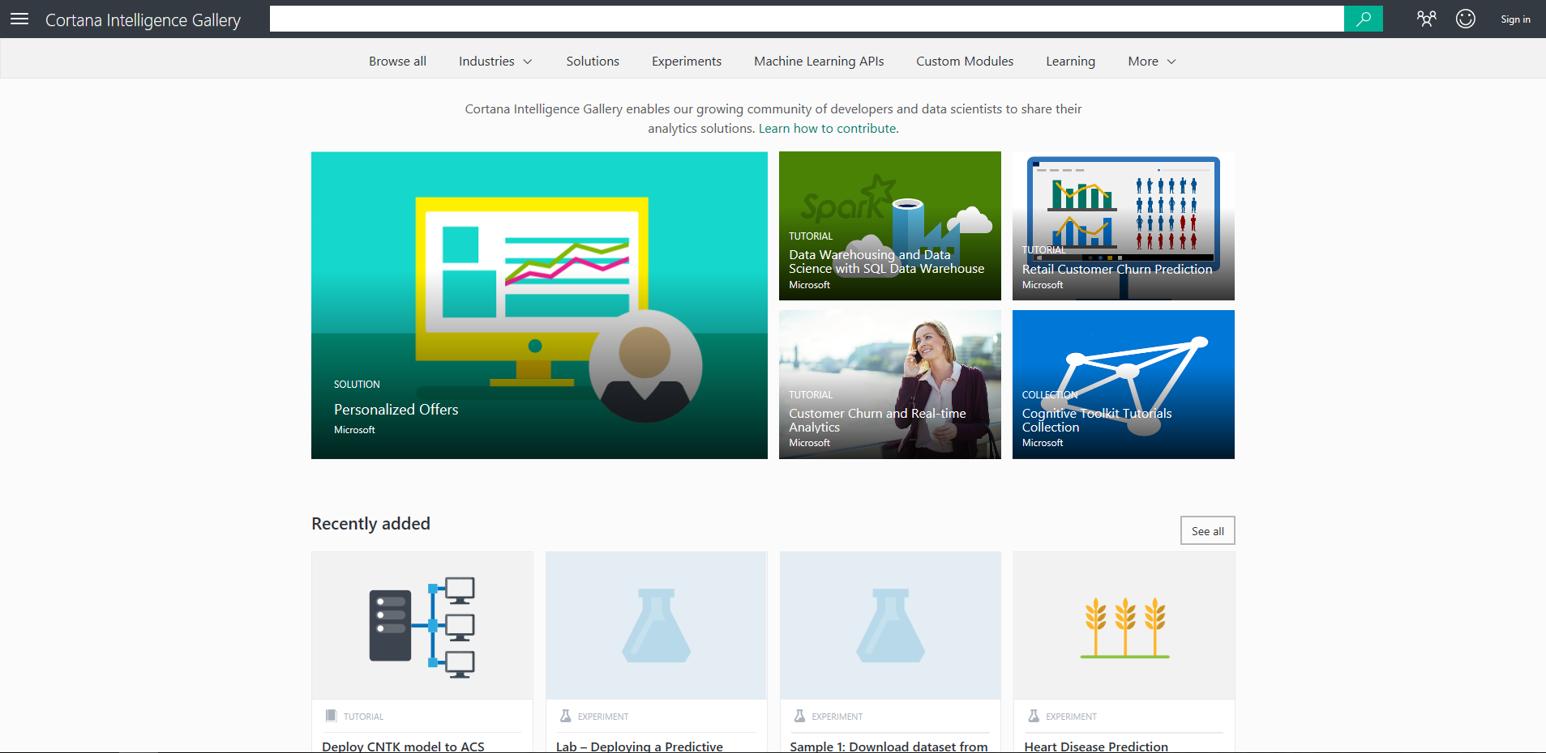
Cortana Intelligence Gallery
Share Analytics Solutions

Slide 16
Cortana Intelligence Lab Exercises
Building a Machine Learning Model
Setup Azure Data Factory
Develop Data Factory Pipeline for Data Movement
Operationalize ML Scoring with Azure ML and Data Factory
Summarize Data Using HDInsight Spark
Visualizing in Power BI Desktop
Acquire Weather API Key
Deploy Intelligent Web App
Cleanup of Azure Resources

Slide 17
Ex 2: Setup Azure Data Factory

Slide 18
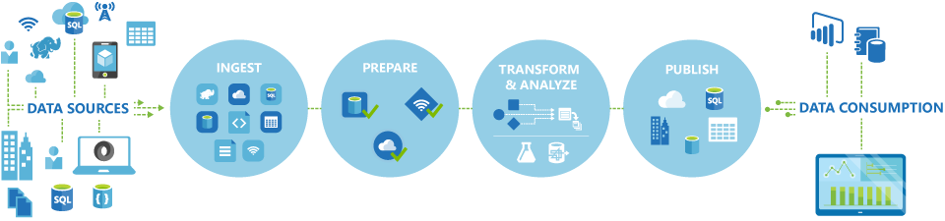
Azure Data Factory
Ex 2: Setup Azure Data Factory
Automates the movement and transformation of data
Create, schedule, orchestrate, and manage data pipelines
Visualize data lineage
Connect to on-premises and cloud data sources
Monitor data pipeline health
Automate cloud resource management
Move relational data for Hadoop processing
Transform with Hive, Pig, or custom code

Slide 19
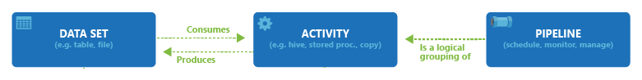
Azure Data Factory
Ex 2: Setup Azure Data Factory
Automates the movement and transformation of data
Create, schedule, orchestrate, and manage data pipelines
Visualize data lineage
Connect to on-premises and cloud data sources
Monitor data pipeline health
Automate cloud resource management
Move relational data for Hadoop processing
Transform with Hive, Pig, or custom code

Slide 20
Ex 2: Setup Azure Data Factory
Tasks
1. Connect to the Lab VM
2. Download and Stage Data to be Processed
3. Install and Configure Data Management Gateway* on the Lab VM
4. Log in to the Azure Portal
5. Create new Azure Data Factory Service and register Data Management Gateway

Slide 21




Azure Data Factory
Ex 2: Setup Azure Data Factory
Data Management Gateway
Software that connects on-premises data sources to cloud services
Connect to on-premises data for Hybrid data access
Define a secure data proxy
Manage your gateway for complete governance
Non-intrusive to corporate firewall
Encrypt credentials with your certificate
Move data efficiently
On-premises
Azure
Data
Movement
Gateway
Files
Firewall
Data Factory

Slide 22
Cortana Intelligence Lab Exercises
Building a Machine Learning Model
Setup Azure Data Factory
Develop Data Factory Pipeline for Data Movement
Operationalize ML Scoring with Azure ML and Data Factory
Summarize Data Using HDInsight Spark
Visualizing in Power BI Desktop
Acquire Weather API Key
Deploy Intelligent Web App
Cleanup of Azure Resources

Slide 23
Ex 3: Develop Data Factory Pipeline for Data Movement

Slide 24

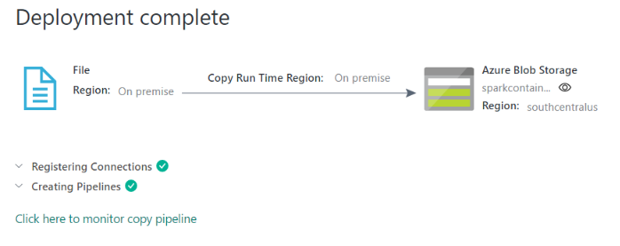
Move Data
Ex 3: Develop Data Factory Pipeline for Data Movement
Copy on-premises data to cloud
Data Factory
Pipeline
Data
Movement
Gateway
Files
Firewall
Files

Slide 25
Ex 3: Develop Data Factory Pipeline for Data Movement
Task
1. Connect to the Lab VM
2. Create Copy Pipeline Using the Copy Data Wizard

Slide 26
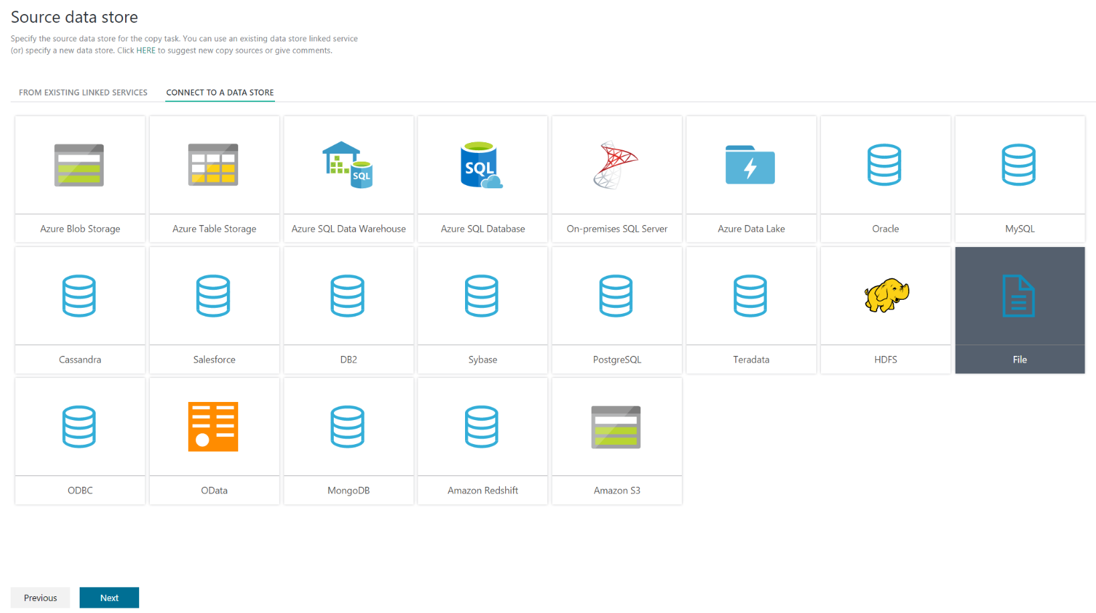
Azure Data Factory
Ex 3: Develop Data Factory Pipeline for Data Movement
Copy Data Wizard
{
"name": "PredictivePipeline",
"properties": {
"description": "Use AzureML model",
"activities": [
{
"type": "AzureMLBatchExecution",
"typeProperties": {
"webServiceInput": "AzureBlobDataInPut",
"webServiceOutputs": {
"output1": "AzureBlobScoredDataOutPut"
},
……
{
"scheduler": {
"frequency": "Minute",
"interval": 60
},
"name": "MLActivity",
"description": "prediction analysis on batch input",
"linkedServiceName": "AzureMLLinkedService"
}
],
"start": "2017-05-24T00:00:00Z",
"end": "2017-05-25T00:00:00Z",
"isPaused": false,
"hubName": "mtcbel-adf_hub",
"pipelineMode": "Scheduled"
}
}

Slide 27
Cortana Intelligence Lab Exercises
Building a Machine Learning Model
Setup Azure Data Factory
Develop Data Factory Pipeline for Data Movement
Operationalize ML Scoring with Azure ML and Data Factory
Summarize Data Using HDInsight Spark
Visualizing in Power BI Desktop
Acquire Weather API Key
Deploy Intelligent Web App
Cleanup of Azure Resources

Slide 28
Ex 4: Operationalize ML Scoring with Azure ML and Data Factory

Slide 29

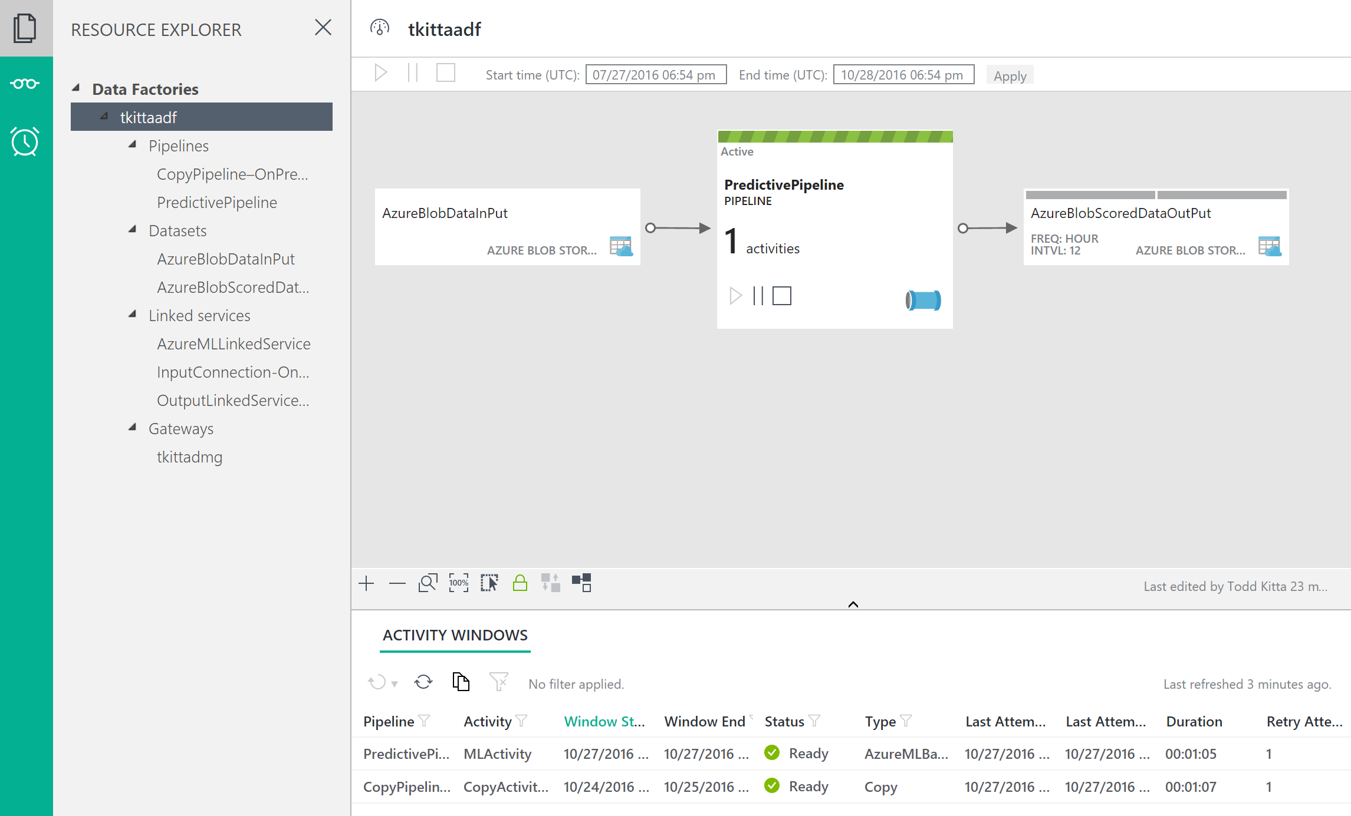
Transform Data
Ex 4: Operationalize ML Scoring with Azure ML and Data Factory
Scoring data using Azure Machine Learning
Data Factory
Machine Learning
Pipeline
?Predict
Files
Files
Next month
Flight Schedules
Next month
Flight Delay
Predictions
Data
Movement
Gateway

Slide 30
Ex 5: Summarize Data Using HDInsight Spark
What you will see next.

Slide 31
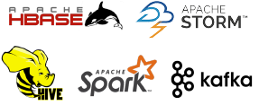

HDInsight
Ex 5: Summarize Data Using HDInsight Spark
Fully Managed Apache Hadoop Cluster
Virtual Machine
Virtual Network
Blob

Slide 32
Ex 5: Summarize Data Using HDInsight Spark
Task
1. Connect to the Lab VM
2. Summarize Delays by Airport

Slide 33
Cortana Intelligence Lab Exercises
Building a Machine Learning Model
Setup Azure Data Factory
Develop Data Factory Pipeline for Data Movement
Operationalize ML Scoring with Azure ML and Data Factory
Summarize Data Using HDInsight Spark
Visualizing in Power BI Desktop
Acquire Weather API Key
Deploy Intelligent Web App
Cleanup of Azure Resources

Slide 34
Ex 6: Visualizing in Power BI Desktop
What you will see next.

Slide 35

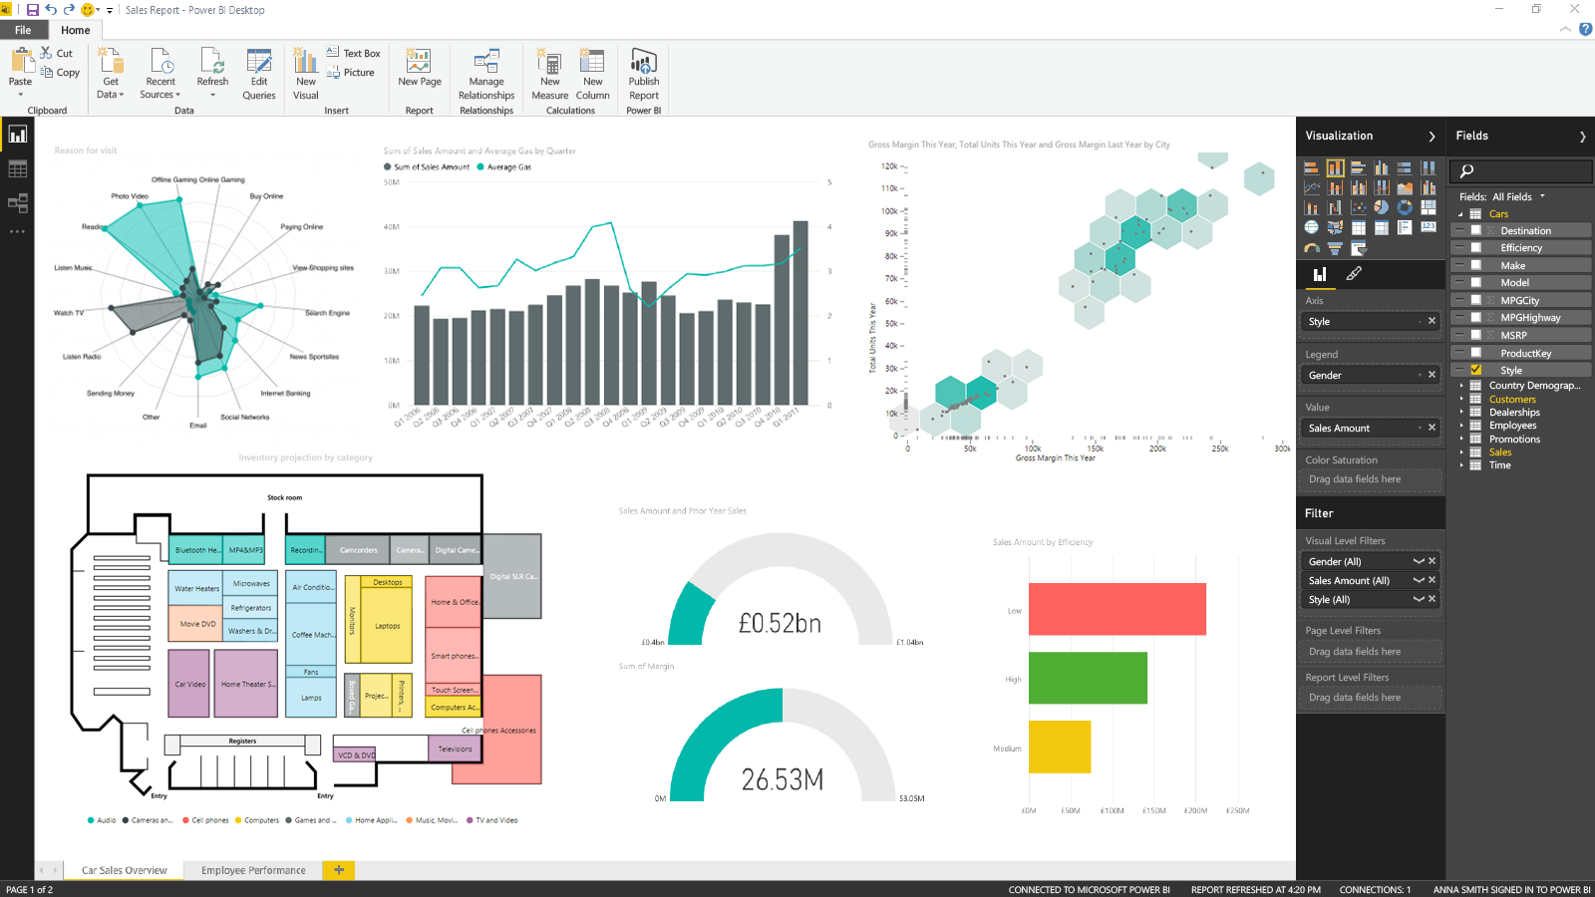
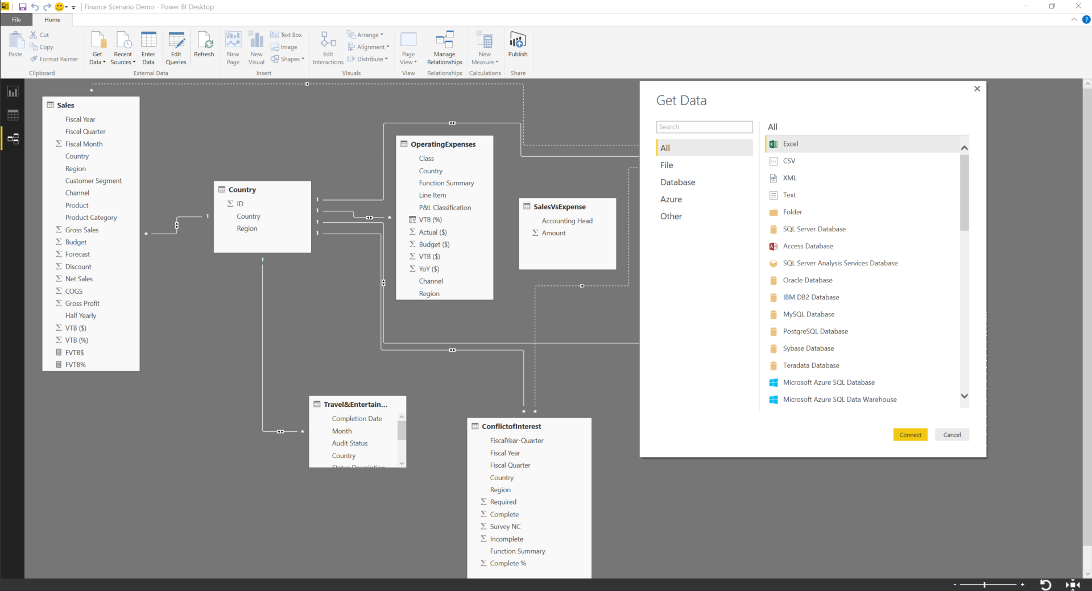
PowerBI Desktop
Ex 6: Visualizing in Power BI Desktop
Create Reports
Discovery & exploration
Easy report authoring
Custom visualizations
R integration

Slide 36
Ex 6: Visualizing in Power BI Desktop
Task
1. Connect to the Lab VM
2. Install PowerBI Desktop
3. Connect to the HDInsight Spark using Power BI Desktop

Slide 37
7.1 Acquire Weather Underground API Key
What you will see next.

Slide 38
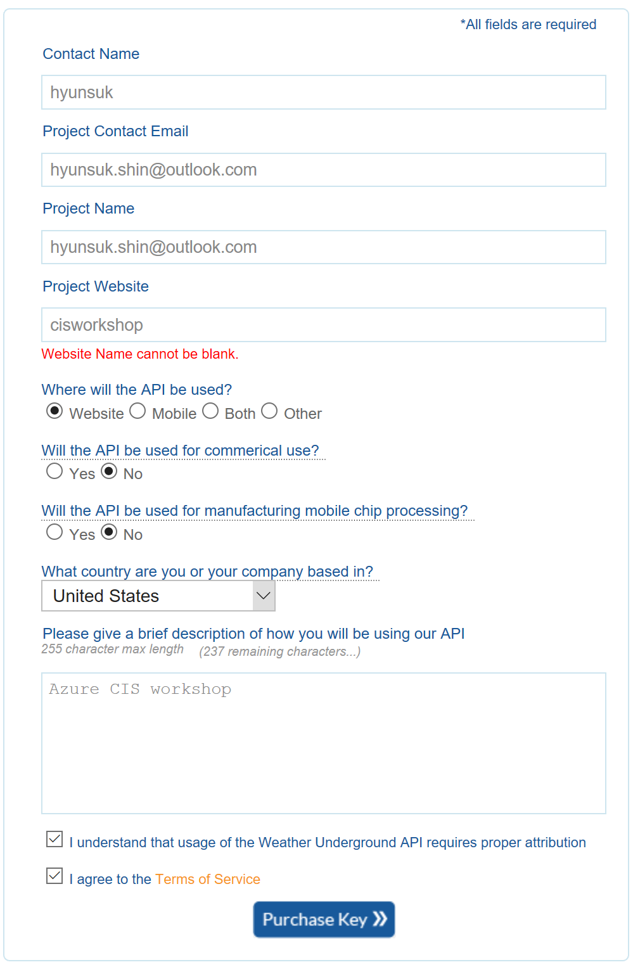
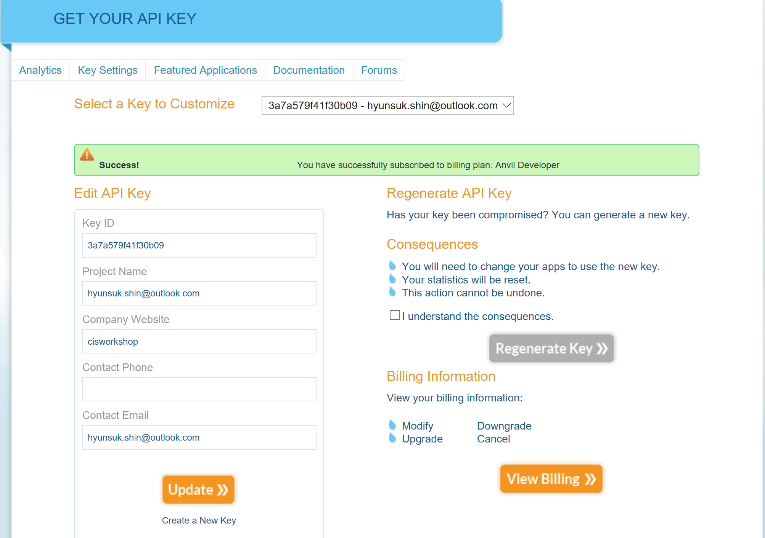
7.1 Acquire Weather Underground API Key
http://api.wunderground.com/api/3a7a579f41f30b09 /forecast10day/q/WA/SEA.json

Slide 39
Ex 7.2: Deploy Intelligent Web App
What you will see next.

Slide 40
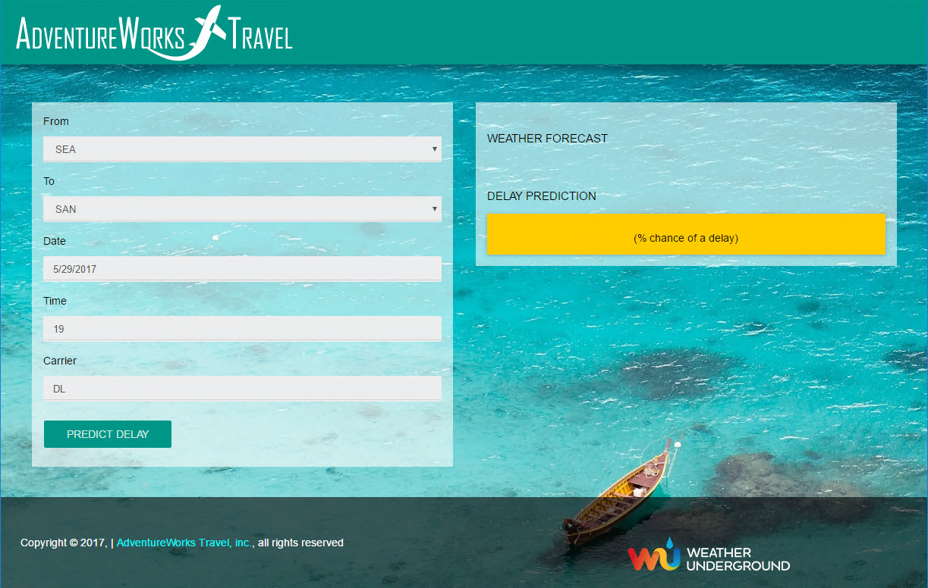
Web App
Ex 7.2: Deploy Intelligent Web App
Fully Managed Web Application Hosting Service
Integrate your Trained Machine Learning Model in your Web App

Slide 41
Ex 7.2: Deploy Intelligent Web App
Task
1. Connect to the Lab VM
2. Deploy Web App from GitHub

Slide 42
Ex 8: Cleanup of Azure Resources
Delete your resource group

Slide 44



Information Management
Information Management
Data Sources
Data Factory
Apps
Data Catalog
Event Hubs
Sensors and devices
Data
Notes:
T: Information Management includes Data Factory, Data Catalog, and Event Hubs.

Slide 45
Compose and orchestrate data services at scale
Information Management
SQL
Data Factory
INGEST
PREPARE
TRANSFORM & ANALYZE
PUBLISH
DATA SOURCES
SQL
SQL
DATA CONSUMPTION
<>
Data Catalog
Event Hubs
SQL
{ }
Create, schedule, orchestrate, and manage data pipelines
Visualize data lineage
Connect to on-premises and cloud data sources
Monitor data pipeline health
Automate cloud resource management
Move relational data for Hadoop processing
Transform with Hive, Pig, or custom code
Notes:
<click>
Data Factory is a globally deployed, fully managed data movement service in the cloud. It enables enterprises to ingest data from multiple on-premises and cloud sources easily, and gets your data where it needs to go. Prepare and partition your data as you ingest it, or apply pre-processing steps.
Data Factory allows enterprises to produce trusted data by easily composing, orchestrating, and monitoring diverse data, transformation and processing services at scale.
You can compose multiple data sources, on premises or in the cloud into highly available, fault tolerant, and streamlined data pipelines. You can process traditional relational data alongside data of different forms and velocities.
Data pipelines operate over the Hadoop ecosystem for transformations with Hive, Pig, and custom code, tying together your traditional relational data with features like automatic cluster management, retries for transient failures, configurable timeout policies, and alerting.
T: Lets look at the next service, Data Catalog
----
The Azure Data Factory service is a fully managed service for composing data storage, processing, and movement services into streamlined, scalable, and reliable data production pipelines. Developers can use Data Factory to transform semi-structured, unstructured and structured data from on-premises and cloud sources into trusted information. Developers build data-driven workflows (pipelines) that join, aggregate and transform data sourced from their on-premises, cloud-based and internet services, and set up complex data processing through simple JSON scripting. The Azure Data Factory service provides monitoring and management of these pipelines at a glance with a rich visual experience offered through the Azure Preview Portal. The information produced by pipelines can be easily consumed using BI and analytics tools, and other applications to reliably drive key business insights and decisions.

Slide 46
Big Data Stores
Information Management
Big Data Stores
Data Sources
Data Factory
Data Lake Store
Apps
Data Catalog
SQL Data
Warehouse
Event Hubs
Sensors and devices
Data
Notes:
T: Azure provides a variety of storage options, including Blobs. Here we’ll dive into the two main storage options with Cortana Intelligence, starting with Data Lake Store.

Slide 47
Machine Learning and Analytics
Information Management
Big Data Stores
Machine Learning and Analytics
Data Sources
Data Lake Store
Machine Learning
Data Factory
SQL Data
Warehouse
Data Lake Analytics
Apps
Data Catalog
HDInsight
(Hadoop and Spark)
Event Hubs
Sensors and devices
Stream Analytics
Data
Intelligence
Notes:
T: Advanced analytics services are where data starts turning into insight that drives intelligent action.

Slide 48
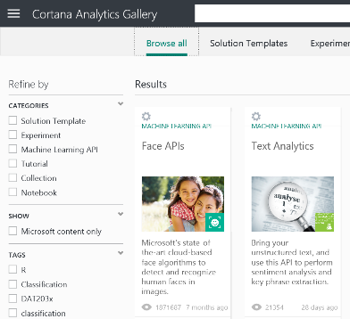
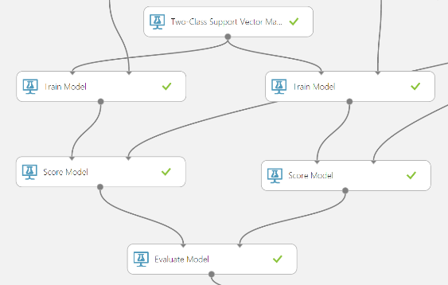
Easily build, deploy, and share predictive analytics solutions
Machine Learning and Analytics
Machine Learning
Data Lake Analytics
HDInsight
(Hadoop and Spark)
Stream Analytics
Simple, scalable, cutting edge. A fully managed cloud service that enables you to easily build, deploy, and share predictive analytics solutions.
Deploy in minutes. Azure Machine Learning means business. You can deploy your model into production as a web service that can be called from any device, anywhere and that can use any data source.
Publish, share, monetize. Share your solution with the world in the Gallery or on the Azure Marketplace.
Notes:
Azure Machine Learning is a fully managed cloud service that enables you to easily build, deploy, and share predictive analytics solutions.
You can deploy your model into production as a web service in minutes—a web service that can be called from any device, anywhere and that can use any data source.
You can also Share your solution with the world in the Gallery or on the Azure Marketplace.
We’ll get into more details about what Machine Learning can do in our demo later on.
T: Next is Data Lake Analytics.

Slide 49
Comprehensive set of managed Apache big data projects
Machine Learning and Analytics
Batch
Map Reduce
Script
Pig
SQL
Hive
NoSQL
HBase
Streaming
Storm
In-Memory
Spark
Machine Learning
Data Lake Analytics
HDInsight
(Hadoop and Spark)
Core Engine
Stream Analytics
Scale to petabytes on demand
Process unstructured and semi-structured data
Develop in Java, .NET, and more
Skip buying and maintaining hardware
Deploy in Windows or Linux
Spin up an Apache Hadoop cluster in minutes
Visualize your Hadoop data in Excel
Easily integrate on-premises Hadoop clusters
Notes:
Azure HDInsight is an Apache Hadoop distribution powered by the cloud. This means that it handles any amount of data, scaling from terabytes to petabytes on demand. Spin up any number of nodes at any time. We charge only for the compute and storage that you use.
Because it's 100 percent Apache Hadoop, HDInsight can process unstructured or semi-structured data from web clickstreams, social media, server logs, devices and sensors, and more. This lets you analyze new sets of data and uncover new business possibilities that drive your organization forward.
HDInsight has powerful programming extensions for languages including C#, Java, and.NET. Use your programming language of choice on Hadoop to create, configure, submit, and monitor Hadoop jobs. With HDInsight, deploy Hadoop in the cloud without buying new hardware or incurring other up-front costs. There’s also no time-consuming installation or set up. Azure does it for you. Launch your first cluster in minutes.
Because it's integrated with Excel, HDInsight lets you visualize and analyze your Hadoop data in compelling new ways using a tool that's familiar to your business users. From Excel, users can select HDInsight as a data source. HDInsight is also integrated with Hortonworks Data Platform, letting you move Hadoop data from an on-site datacenter to the Azure cloud for backup, Dev/Test, and cloud-bursting scenarios. Using the Microsoft Analytics Platform System, you can even query your on-premises and cloud-based Hadoop clusters at the same time.
T: Next up is Azure Stream Analytics

Slide 50
Dashboards & Visualizations
Information Management
Big Data Stores
Machine Learning and Analytics
Intelligence
Data Sources
Data Factory
Data Lake Store
Machine Learning
Cognitive Services
Data Catalog
SQL Data
Warehouse
Data Lake Analytics
Bot Framework
Apps
HDInsight
(Hadoop and Spark)
Event Hubs
Cortana
Sensors and devices
Stream Analytics
Dashboards & Visualizations
Power BI
Data
Data
Intelligence
Notes:
Many of the services we’ve been talking about today are on the back-end. But your data and the results of analytics are only useful if they can be provided to those who need them – often people without deep data expertise.
That’s where Power BI comes in. Power BI is a cloud-based dashboard and visualization service that provides faster time to insight. It is used for visualizing, exploring and extracting insights from data. It brings together data from diverse sources to deliver rich, comprehensive views of your business. With Power BI, you can see all of your data in one place and share reports. Live dashboards and reports show visualizations and KPIs from data that reside both on-premises and in the cloud, providing a consolidated view across your business regardless of where your data lives.
T: Now that we’ve walked through everything, let’s take a look at the whole picture.

Slide 51
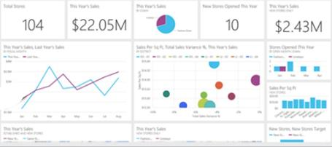
Keep a pulse on your business with live, interactive dashboards
Stream Analytics
Event Hubs
Power BI
Machine Learning
Storage
Power BI
Dashboards & Visualizations
SQL database
Power BI
HDInsight
Power BI
Analytics for everyone, even non-data experts
Your whole business on one dashboard
Create stunning, interactive reports
Drive consistent analysis across your organization
Embed visuals in your applications
Get real-time alerts when things change
Notes:
Many of the services we’ve been talking about today are on the back-end. But your data and the results of analytics are only useful if they can be provided to those who need them – often people without deep data expertise.
That’s where Power BI comes in. Power BI is a cloud-based dashboard and visualization service that provides faster time to insight. It is used for visualizing, exploring and extracting insights from data. It brings together data from diverse sources to deliver rich, comprehensive views of your business. With Power BI, you can see all of your data in one place and share reports. Live dashboards and reports show visualizations and KPIs from data that reside both on-premises and in the cloud, providing a consolidated view across your business regardless of where your data lives.
T: Now that we’ve walked through everything, let’s take a look at the whole picture.

Slide 52
Transform data into intelligent action
Information Management
Big Data Stores
Machine Learning and Analytics
Intelligence
People
Data Sources
Data Factory
Data Lake Store
Machine Learning
Cognitive Services
Data Catalog
SQL Data
Warehouse
Data Lake Analytics
Bot Framework
Web
Apps
HDInsight
(Hadoop and Spark)
Mobile
Event Hubs
Cortana
Apps
Bots
Sensors and devices
Stream Analytics
Dashboards & Visualizations
Automated Systems
Power BI
Data
Data
Intelligence
Action
Notes:
T: Cortana Intelligence provides everything you need to transform your organization’s data into intelligent action. Next, let’s take a look at another demo.

